Slide 1
Quick Base Craft Demo
[Software Engineering Coop]
[11/10/2020]

Slide 2
Introduction
Life Motto-
“Life is about doing things that matter first, not last”- Richie Norton
Education
Master of Science in Information Systems
Bachelor of Technology in Computer Engineering
Technical Skills
Programming Languages: Java, JavaScript, Python, HTML, CSS
Frameworks: ReactJS, Node.js, AJAX, Spring MVC, Hibernate, JSP, Redux, jQuery, Vue, Element UI, Material UI
Database: MySQL, MongoDB
Version Control: Git, Bitbucket
Testing Frameworks: Selenium
Tools: Eclipse, NetBeans, Microsoft Visual Code, Anaconda Navigator
Work Experience
Software Engineer (January 2017- April 2019) at Infosys Limited

Slide 3
Academic Projects
Dental Insurance System
Problem: This is a system used by dental clinics, patients, insurance companies throughout the whole reservation, treatment, referral and payment process. The problem is that there are too many insurance plans and too many dental clinics for patients, so this system mainly wants to find a method to help them find best fit. Also, we want to find a way to keep all the patients’ personal information and medical / treatment history so that they can be referred to another organization easily.
Result: Proposed various entities to resolve the issue
1. Patients
Personal Information
Medical History
Directory of Treatment Plan
Directory of Appointment
Directory of Insurance Policy
2. Dental Clinics
Directory of Patient
Directory of Appointment
Directory of Employee
Employee
Personal Information
Role: Receptionist, Manager, Doctor
Treatment History (Directory of Appointment note)
Appointment note
3. Insurance Companies
Directory of Customer (Patients)
Directory of Policy
Policy
Payment History (Directory of Payment History)
Insurance products and coverage

Slide 4
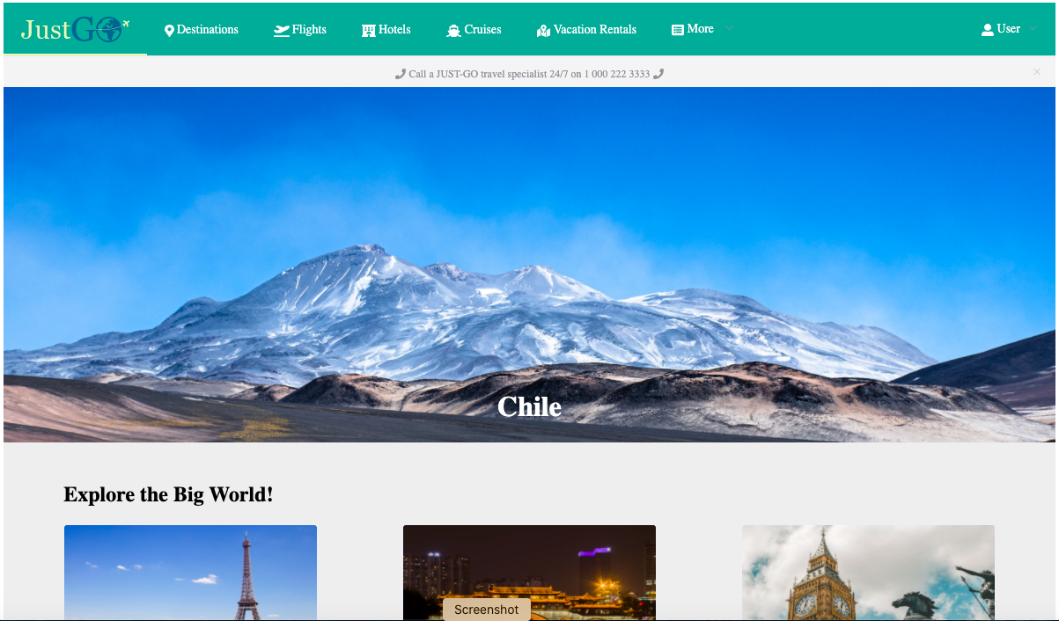
Academic Projects
Travel Website
Problem: To keep a track of travel history at one place.
Result : Just-Go is a travel website that allows customers to register and sign-in, browse trending travel information of popular places, browse high-rating hotels, book and search flight tickets to travel destinations and place orders directly through the website.

Slide 5
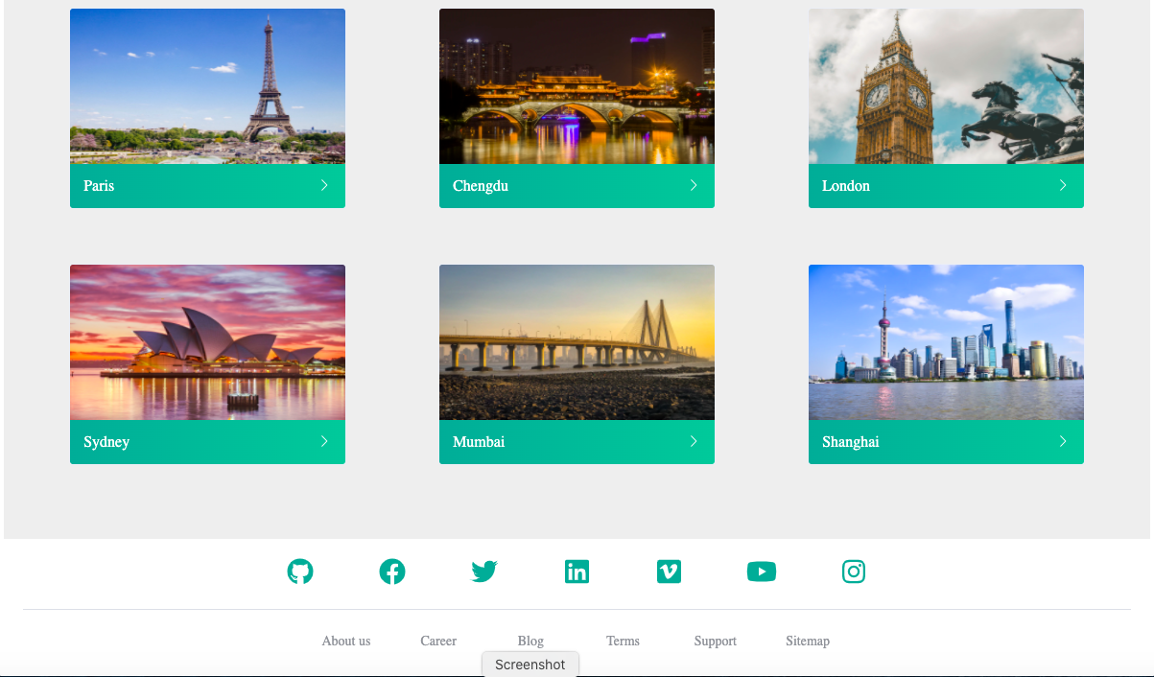
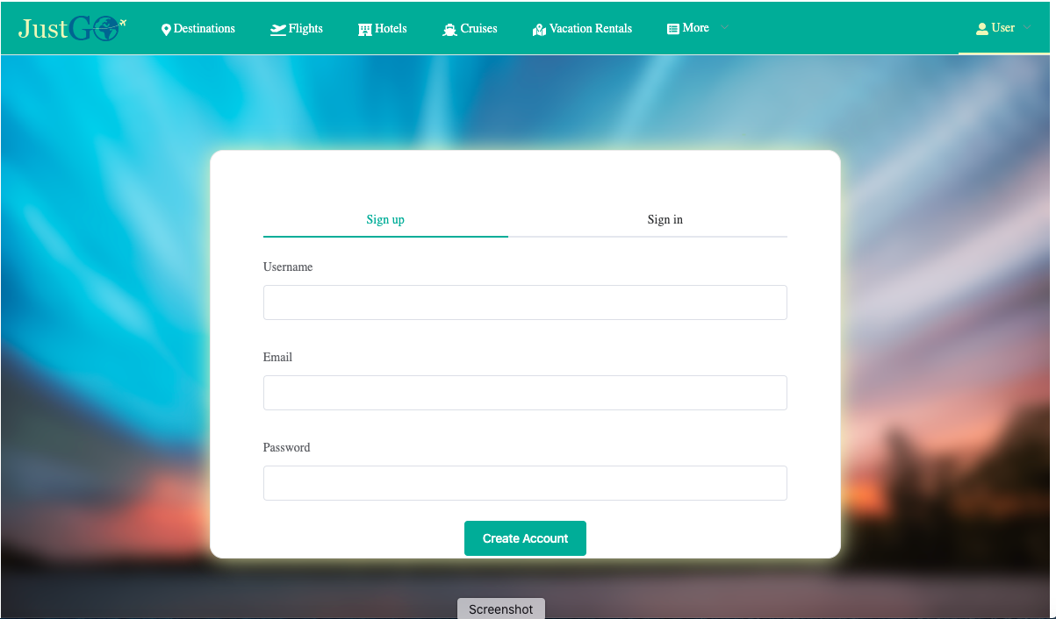
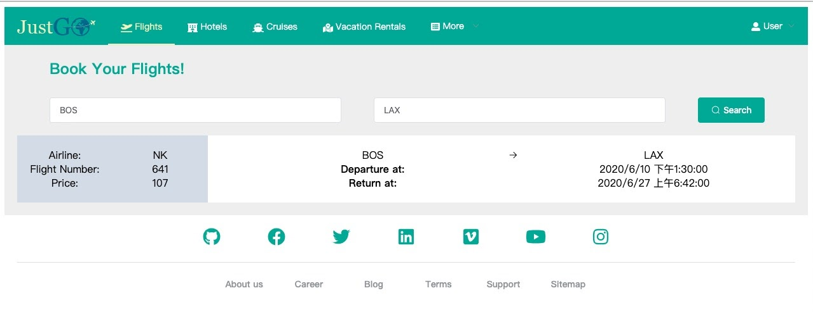
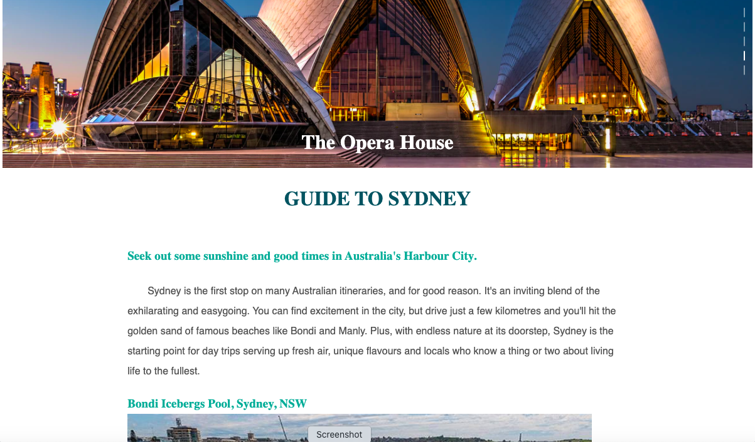
Screenshots from Travel Website

Slide 6
Craft Demo
and discussion

Slide 7
Problem Description
To work on an admin controls of a product so that it allows builders to set up their own input forms.
As shown in the image below form will allow user to modify the input fields according to their preferences.

Slide 8
Core Requirements
The builder can add and remove choices from the list of choices. In the visual spec provided, the builder adds and removes choices in a textarea element. Individual items are separated by a new line. Feel free to modify this interaction to meet the requirement of being able to add and remove choices.
Validate the following rules and notify the builder if there are any validation issues.
The Label field is required.
Duplicates choices are not allowed.
There cannot be more than 50 choices total.
If the default value is not one of the choices, it should be added to the list of choices when the field is saved.
For the purpose of the demo, you may want the form to keep its values after the form is submitted. This helps demonstrate the prior requirement (that the default value is added).
Add a button that allows the builder to clear the form and start fresh.
The submit button should create a json object and post it to http://www.mocky.io/v2/566061f21200008e3aabd919. It should also log the post data to the console. You can add a function to FieldService in MockFieldService.js to accomplish this, but everything is up to you. Feel free to modify or change anything you would like as long as it meets the minimum requirement of posting json data to the back-end endpoint.

Slide 9
Stretched Requirements
Allow the form to be responsive and work on mobile devices in addition to desktop.
Have you ever closed the browser accidentally when working on something? Yeah, me too. Let's help the user out by populating the form with the input they were working on if they accidentally close the browser.
The database that stores this does not allow individual choices in the list of choices to be longer than 40 characters. Add client-side validation such that excess characters are visually distinct if the choice is longer than 40 characters. I.e., if a user enters the word that is longer than 40 characters, the characters above 40 would be highlighted in red.
Refactor the button component such that it could be used by other developers and maintain the same style and behaviour (e.g., for a custom component library). For example, let's say we want all of our submit buttons to show a loading indicator after they are clicked. How could we create a component that has that behavior that would be shared across all instances of the submit button?

Slide 10
Technologies and Frameworks Used
JavaScript
React
Material UI
CSS
ES6
HTML

Slide 11
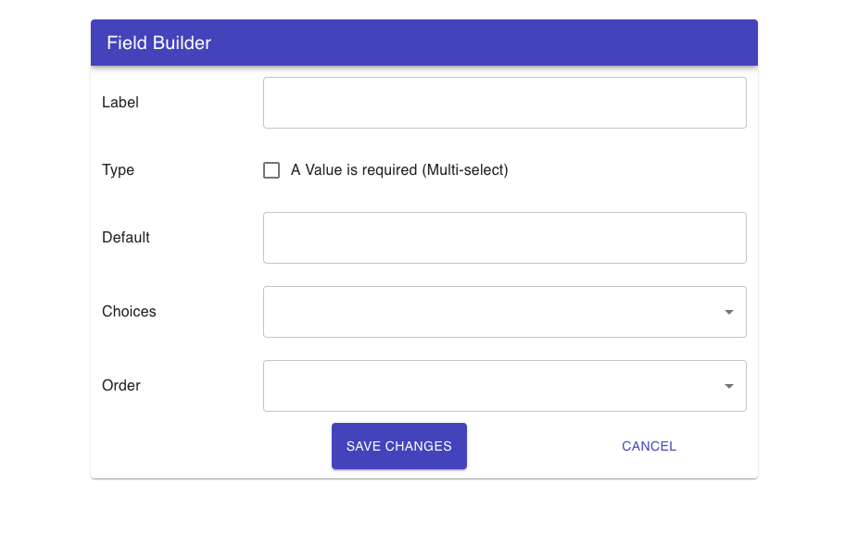
Designed Form

Slide 12
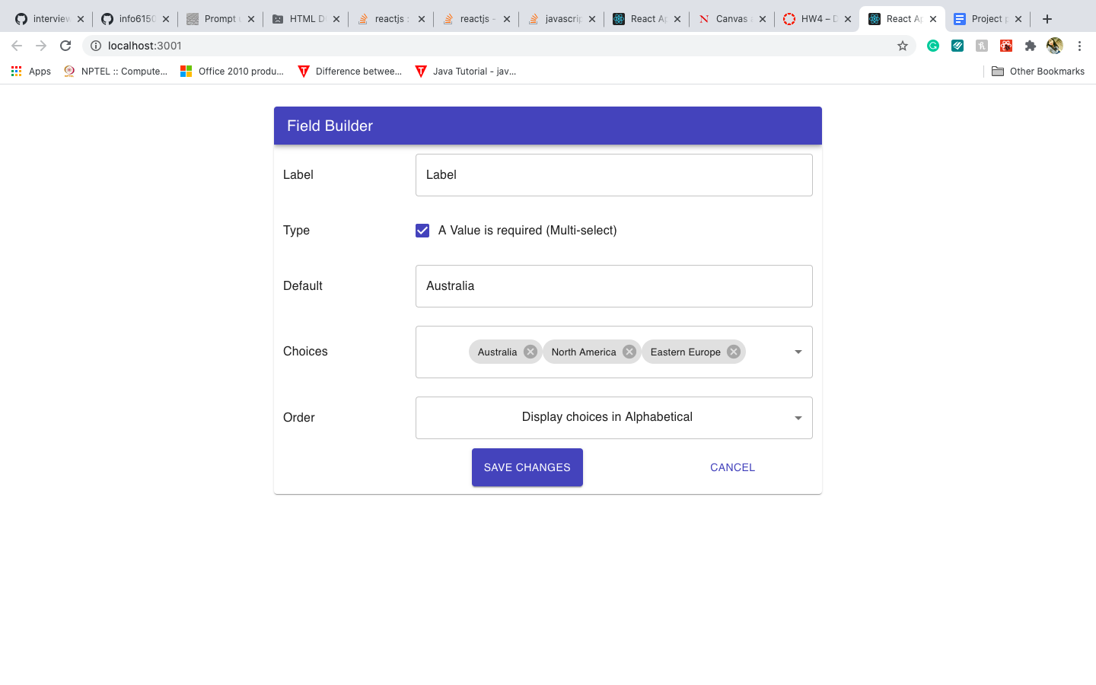
Form with Input Values

Slide 13
Challenges Faced
Usage of Functional or Class components
Implementing React Lifecycle methods effectively
Whether to use react hooks or not
Correct usage of React components
How to store input field data after the submission of Form

Slide 14
Conclusion
Built a responsive form for various types of input fields
Learned different react lifecycle methods
Learned Material UI framework

Slide 15
Thank You

